Slide 1
Cloud Security Monitoring System
with Incident Management Assistance
A centralized platform for infrastructure visibility, security monitoring, incident response and AI-assisted operations.
TEAM 1
Hemanth Narasimha Satti • Praveen Ramnath J • Rocky Kumar AAKASH P • Sakshi Pawar

Slide 2
• INTRODUCTION
A unified security operations workspace for infrastructure, risks and incidents.
01
02
03
04
24×7 Visibility
RBAC
Live Metrics
One Hub
Centralized view of infrastructure health and security posture.
Role-based access for ADMIN, ITSM and USER roles.
CPU, memory, disk, GPU and network activity.
Assets, alerts, incidents and vulnerabilities in one workspace.
CORE IDEA
Monitor → Detect → Understand → Respond → Secure

Slide 3
• CHALLENGE
Why the problem matters
Security operations become harder when infrastructure, alerts and incident workflows are fragmented.
1
Fragmented visibility
Teams need a single view of assets, alerts and incidents.
2
Manual discovery
Infrastructure inventory is difficult to maintain consistently.
3
Missed risk signals
High-risk conditions can be overlooked when monitoring is fragmented.
4
Slow response
Incident handling benefits from centralized status, ownership and context.

Slide 4
• PROPOSED SOLUTION
A security operations center in one web platform
The solution connects monitoring, security signals, user access and incident workflows.
1
2
3
4
Discover
Monitor
Detect
Respond
Assets & infrastructure
Health & resource metrics
Alerts, risk & vulnerabilities
Incidents, ownership & action
SECURITY PRINCIPLE
AI assists operations; authentication and RBAC remain the authorization boundary.

Slide 5
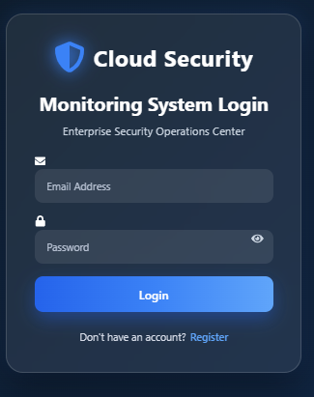
• SECURE USER ACCESS
Secure User Access
Authentication is the first layer protecting the monitoring platform.
1
Email + Password
Standard sign-in for registered users.
2
BCrypt
Passwords are stored as hashes, not plain text.
3
JWT
Successful authentication issues a token for protected API requests.
4
HTTPS
Frontend communicates securely with the backend in deployment.
5
RBAC
Spring Security controls access by user role.

Slide 6
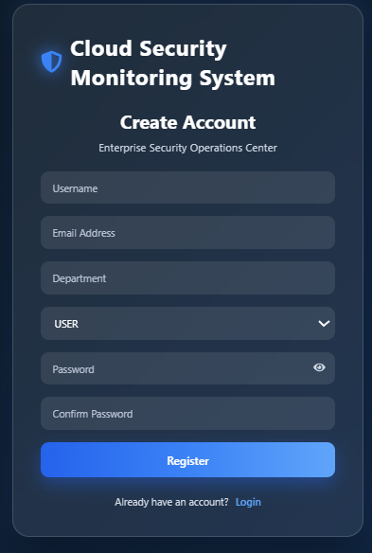
• REGISTRATION
Registration & Email Verification
Controlled onboarding before protected features become available.
01
02
03
04
05
Register
Token
Email
Verify
Login
● Username and email are normalized before storage.
● New accounts start disabled and unverified.
● A unique verification token is generated with a 24-hour expiry.
● Verification activates the account for login.
24-HOUR TOKEN

Slide 7
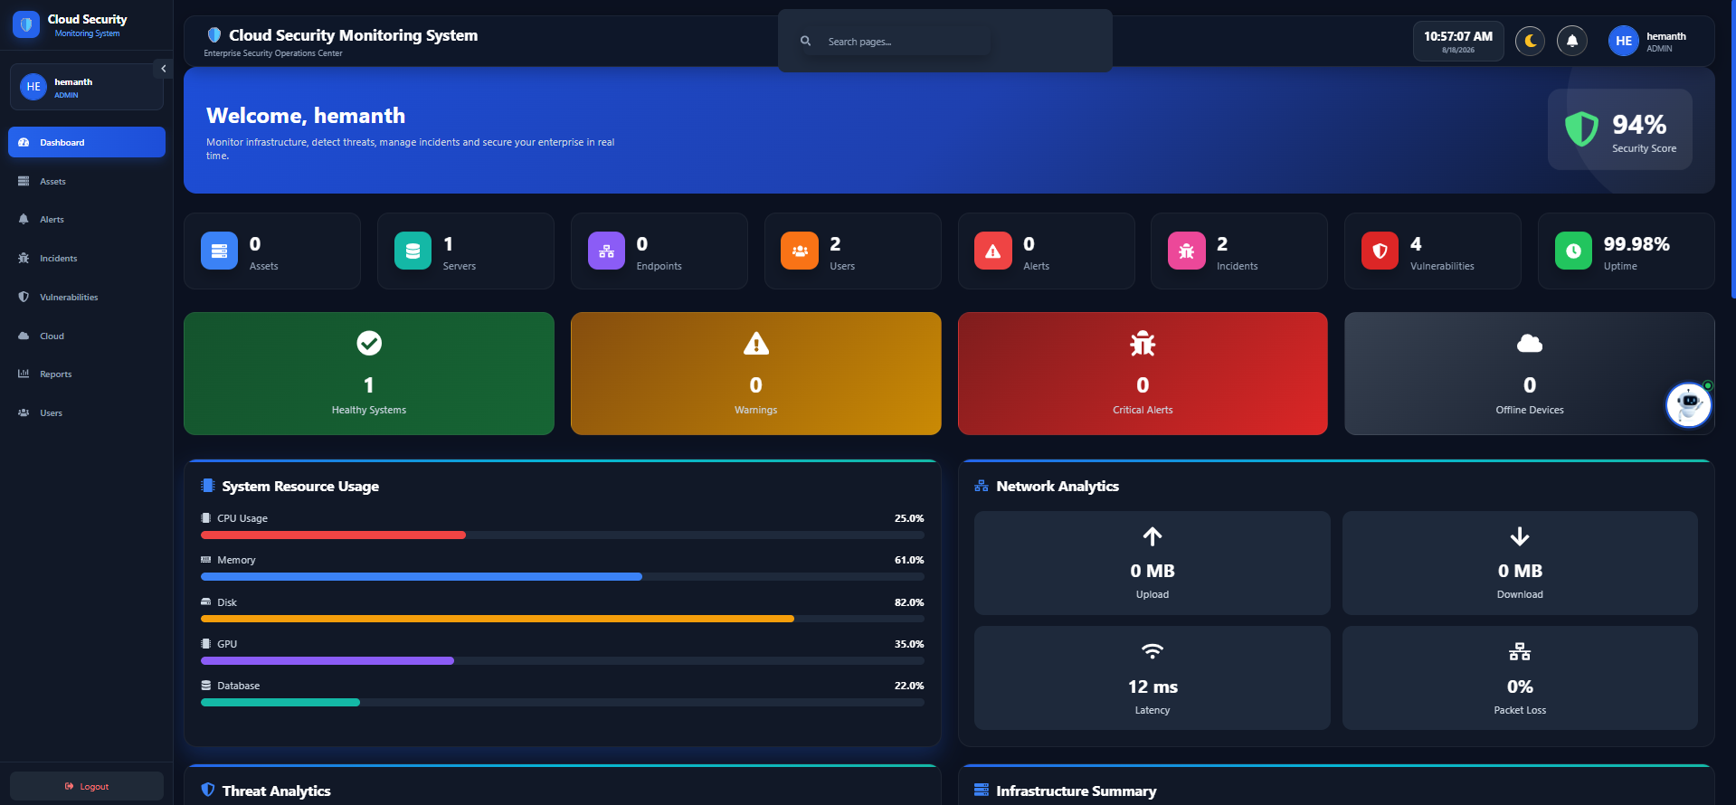
• DASHBOARD
Security Operations Dashboard
A single screen for infrastructure health, security posture and operational priorities.
LIVE SECURITY POSTURE
07

Slide 8
• CORE MODULES
Core Modules
Operational and security workflows brought together in one platform.
01
02
03
04
Asset Management
Monitoring
Alerts
Incidents
Discover, register, search and monitor infrastructure.
Track CPU, memory, disk, GPU and network activity.
Surface abnormal conditions and security signals.
Centralize status, ownership and response.
05
06
07
08
Vulnerabilities
Reports
Cloud
Users & RBAC
Maintain visibility into vulnerability exposure.
Provide operational and security information for review.
Present cloud/infrastructure security information in one workspace.
Control access for ADMIN, ITSM and USER roles.

Slide 9
• INFRASTRUCTURE
Infrastructure & Asset Monitoring
From discovery to health and risk scoring.
AUTO DISCOVERY
HEALTH & RISK
● Hostname and IP address
● MAC address and network details
● Operating system and architecture
● Processor and CPU core information
● Memory, disk and network utilization
● Discovery and last-seen timestamps
CPU
40%
Memory
95%
Disk
59%
GPU
35%
Risk score derives from resource pressure, network activity and critical health state.

Slide 10
• INCIDENT RESPONSE
Incident Management Assistance
Turning security signals into an organized response workflow.
01
02
03
04
05
Detect
Assess
Assign
Respond
Resolve
Alert / anomaly
Severity + risk
Owner / team
Investigate + act
Close + record
WHY IT MATTERS
Alerts + incidents + vulnerabilities + asset context = better prioritization.

Slide 11
• AI
AI-Powered Security Assistant — Spring AI
Natural-language interaction that helps users navigate and understand the security workspace.
SPRING AI
Example interaction
What the assistant can do
"Go to alerts page"
● Understand natural-language security requests.
● Navigate to Dashboard, Assets, Alerts, Incidents and more.
● Provide security recommendations and operational guidance.
● Return structured actions such as NAVIGATE or informational responses.
● Work behind authenticated Spring Security and RBAC controls.
/alerts
AI assists the user; Spring Security and RBAC remain responsible for authorization.

Slide 12
• SECURITY
Security & Access Control
Layered controls protect users, APIs, services and application data.
Frontend
React UI • protected routes • token-aware API client
ROLE MODEL
API
Spring Boot REST controllers • validation • CORS
ADMIN
Full control
Security
Spring Security • JWT filter • role-based authorization
ITSM
Manage assets
Data
PostgreSQL • JPA/Hibernate • BCrypt password hashing
USER
View access
Services
Email verification • monitoring services • incident workflows

Slide 13
• ARCHITECTURE
System Architecture & Data Flow
How the major components work together.
React Frontend
REST API
Security Layer
PostgreSQL
Login • Dashboard • Assets Alerts • Incidents
Auth • Assets • Dashboard Security modules
JWT • RBAC • CORS Validation
Users • Assets • Tokens Security records
Supporting Services
OSHI / system metrics • Email verification • Monitoring & risk calculations • Incident assistance

Slide 14
• AI ARCHITECTURE
AI Assistant Architecture
A secure path from natural-language input to an authorized application action.
React AI Assistant
Spring Boot + Spring AI
Security Services + Context
PostgreSQL / Monitoring Data
Deployment option
Local-model deployment can be used when no external API key is desired.

Slide 15
• AI INTERACTION
AI Interaction Workflow
How a natural-language request becomes a secure application action.
1
2
3
4
5
User asks
JWT verified
Spring AI
Intent / action
Response
“Show alerts”
Authenticated session
Interpret request
Select secure operation
Message or navigation
SECURITY PRINCIPLE
AI chooses assistance; authorization is enforced by the security layer.

Slide 16
• TECHNOLOGY
Technology Stack
Core technologies used to build the solution, including Spring AI.
Frontend
React + Vite
Backend
Spring Boot
Responsive security dashboard
REST APIs and business logic
AI Integration
Spring AI
Security
Spring Security + JWT
AI orchestration and assistant integration
Authentication and authorization
Database
PostgreSQL + JPA
Monitoring
OSHI
Persistent application data
Hardware and system information
Email
JavaMailSender / SMTP
Verification messages

Slide 17
• WORKFLOW
End-to-End Workflow
A simple view of how a user interacts with the platform.
1
2
3
4
5
6
Register
Verify
Login
Monitor
Detect
Respond
Create account
Confirm email
Receive JWT
View assets & health
Review alerts / risks
Manage incidents
GOAL
Reduce the time between detection, understanding and response.

Slide 18
Team Members
HS
PJ
RK
AP
SP
Hemanth Narasimha Satti
Praveen Ramnath J
Rocky Kumar
AAKASH P
Sakshi Pawar
• Team 1

Slide 19
• CONCLUSION
Monitor. Detect. Respond. Secure.
Cloud Security Monitoring System with Incident Management Assistance
THANK YOU
Questions & Discussion
● Centralized infrastructure and security visibility.
● Secure authentication, JWT and role-based access.
● Incident and vulnerability management workflows.
● Spring AI-powered natural-language assistance.
● Designed for extensibility and local AI deployment without requiring an external API key.
MONITOR
DETECT
RESPOND
SECURE

